Slide 1


Slide 2

OneCare, an innovative all-in-one healthcare web app designed to revolutionize the way you manage your health and wellness.
CS 691 CAPSTONE PROJECT

Slide 3
Agenda
Team Member Roles and Responsiblities
Improvements made from Professor Feedback
Project Description
Team working agreement
MVP.
Personas (at least 3)
Product Backlog
Diagrams (Architecture Diagrams, Context Diagram, ER Diagrams, Sequence Diagram, State Diagrams)
Stories and Acceptance Criteria
Test Cases
Stories or Tasks committed for this Sprint
Metrics
Team velocity - this sprint
Burndown Charts
Technologies.
Retrospective
Stories planned for Sprint 2
Figma Designs
Project Demo
Github URL

Slide 4
TEAM MEMBERS AND ROLES

Slide 5

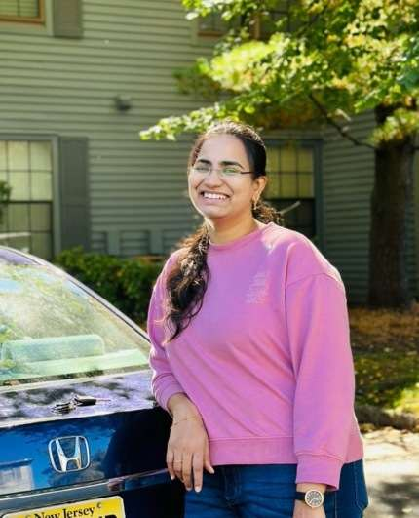
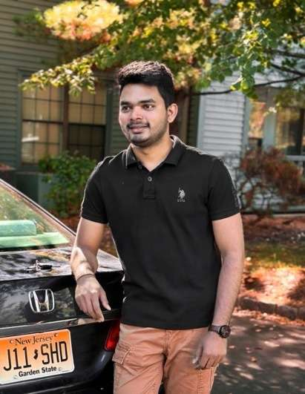
TEAM MEMBERS AND ROLES
Aishwarya More Software Developer & Business analyst (am99715n@pace.edu)
Naga Lavanya Mukku Backend Developer & Software test Engineer (nm26028n@pace.edu)
Shiva Krishna Maddela Software Developer & Devops Engineer (sm69485n@pace.edu)

Slide 6
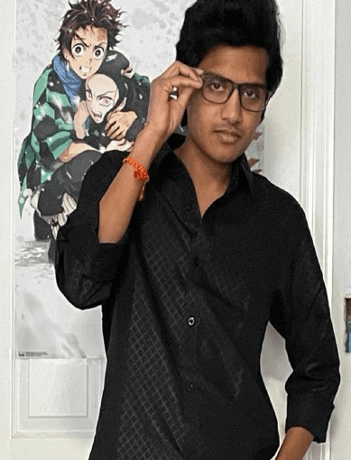

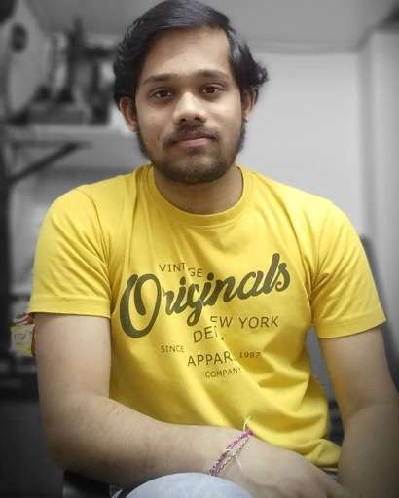
TEAM MEMBERS AND ROLES
Pushpak Kamisetti Software Developer & Machine Learning Engineer (pk39545n@pace.edu)
Afroze Fatima Software Developer (an75415n@pace.edu)
Shashidhar pinumalla Front End Developer (sp16592n@pace.edu)

Slide 7
PROJECT DESCRIPTION
OneCare is a comprehensive healthcare management application designed for both patients and doctors. It serves as a unified platform that facilitates seamless communication, appointment scheduling, and the organization of medical records, predict medicines based on symptoms using Deep learning Neural network (LSTM), medication reminders to stay on track with their treatment plans, while stress management tools, such as recorded meditation sessions, promote mental well-being. OneCare aims to simplify healthcare management and promote healthier lifestyles. Our app, OneCare Health, leverages Firebase's real-time database and authentication features to provide a seamless and secure experience for users. It enables patients to manage their health records, appointments, and prescriptions, while healthcare providers can efficiently access patient information and communicate with their patients.

Slide 8
Improvements made from Professor Feedback
Post the deliverable for sprint 0 presentation, we received feedback from the professor on changing
the personas format and making few changes in our Power point presentation and the deliverable
presentation which we did accordingly which can be seen in the further slides.

Slide 9

Team Working Agreement

Slide 10
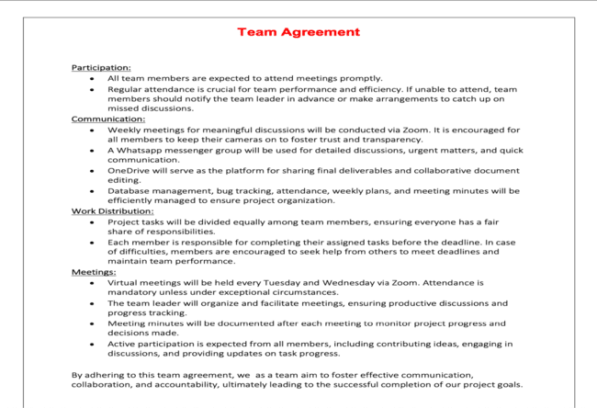

Slide 11

MINIMAL VIABLE PRODUCT

Slide 12

The following are the features that we are covering in our MVP:
Patient Login Feature: [login screen for patient]
Doctor Login Feature: [ login screen for doctor]
Doctor Home Feature: [dashboard for doctors]
Patient Home Feature: [dashboard for patients ]
Signup Feature: [Signup screen for patient as a new user]
Forgot Password Feature: [Password reset ]
Appointment Booking Feature: [Book appointment screen]
This MVP will allow users to perform essential functions like logging in, signing up, booking appointments, and accessing home screens tailored for both doctors and patients.

Slide 13
Personas

Slide 14
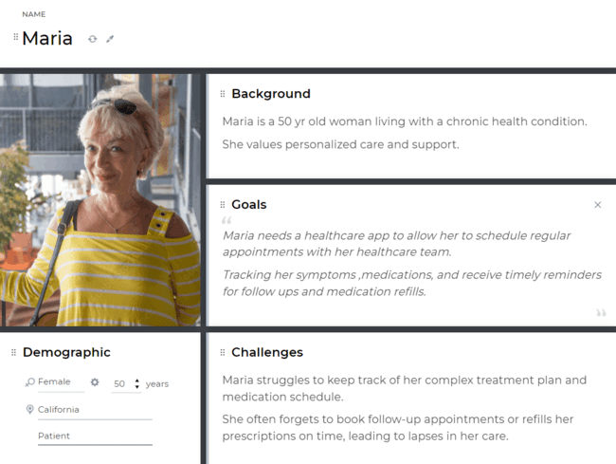

Slide 15
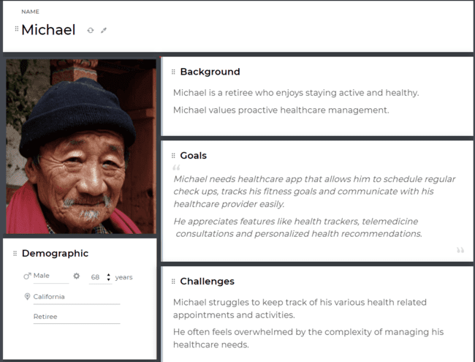

Slide 16
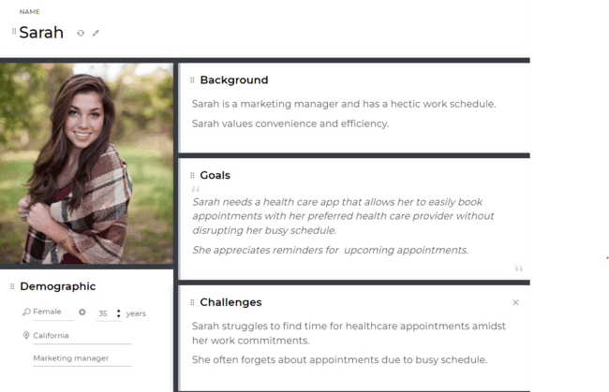

Slide 17

PRODUCT BACKLOG

Slide 18
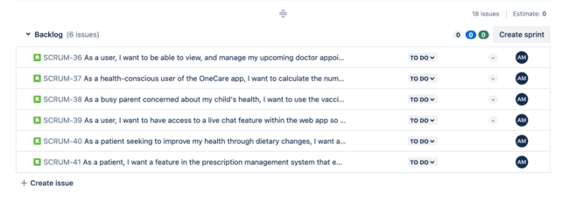

Slide 19
ARCHITECTURE DIAGRAM

Slide 20
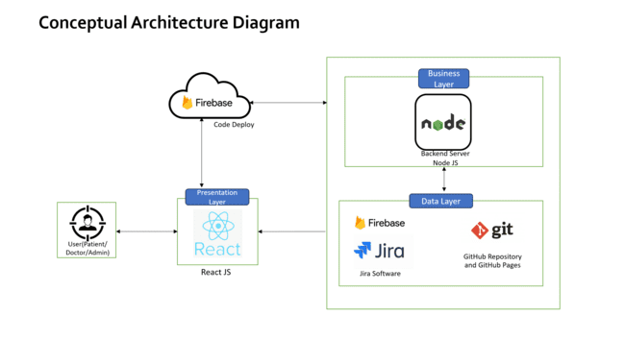

Slide 21
SEQUENCE DIAGRAM

Slide 22
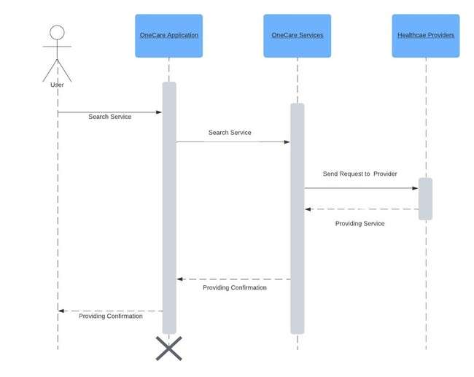

Slide 23

ACCEPTANCE CRITERIA AND USER STORIES

Slide 24
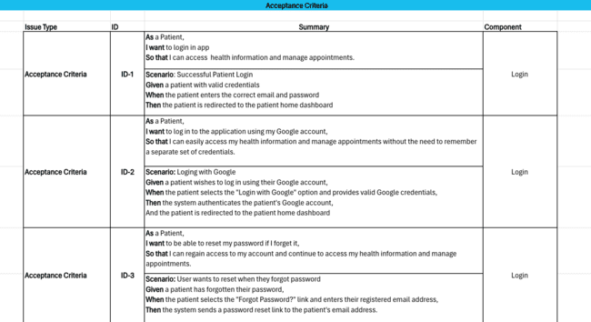
ACCEPTANCE CRITERIA AND USER STORIES

Slide 25
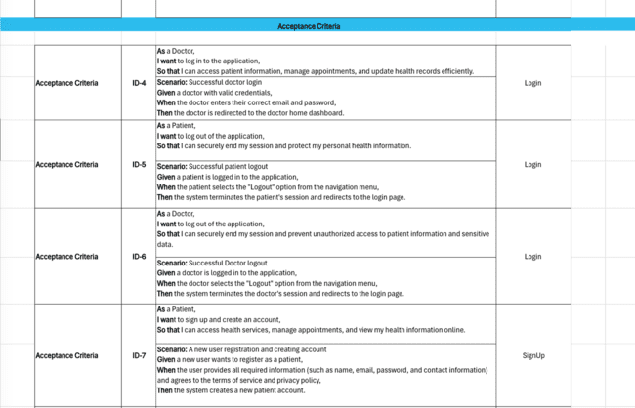
ACCEPTANCE CRITERIA AND USER STORIES

Slide 26
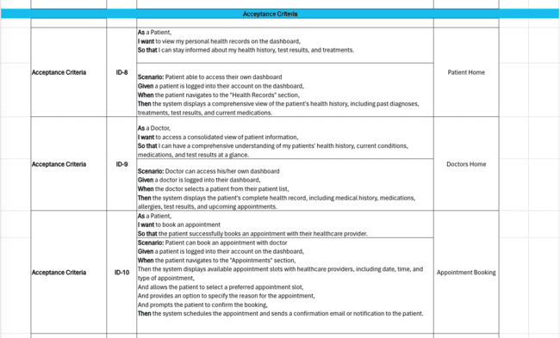
ACCEPTANCE CRITERIA AND USER STORIES

Slide 27
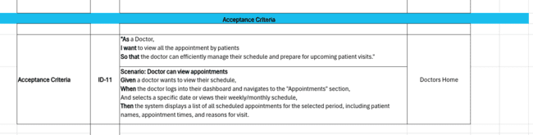
ACCEPTANCE CRITERIA AND USER STORIES

Slide 28
TESTCASES

Slide 29
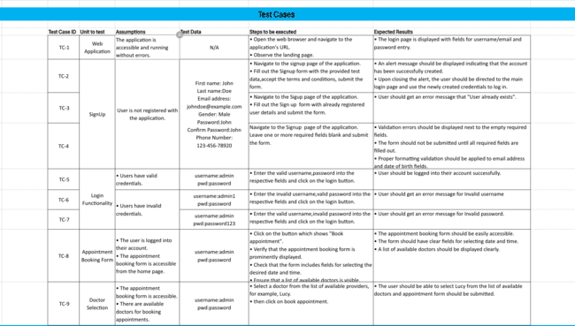

Slide 30
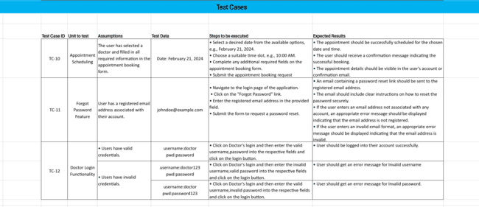

Slide 31
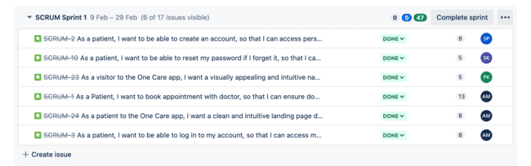
Stories Completed In sprint 1

Slide 32

Metrics

Slide 33
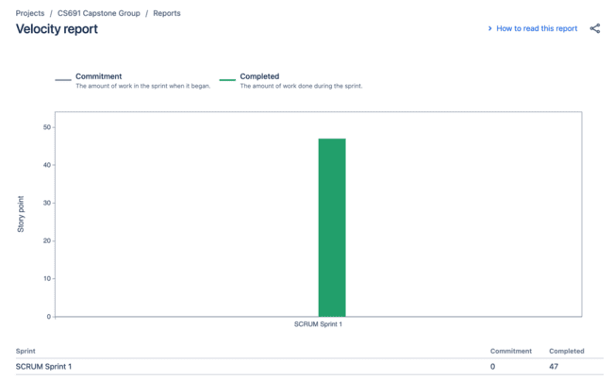
Team Members Velocity report

Slide 34
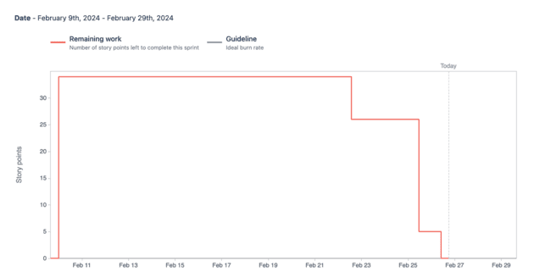
Sprint Burndown Chart

Slide 35












Technologies

Slide 36
RETROSPECTIVE

Slide 37
Retrospective
We were able to complete all commited user stories in the sprint and also integrate cloud storage with firebase
What Went Well
Submission of a particular user story should be done on the given date. Integration of the code on git by all users
What needs improvement
During our weekly meeting we can ask everyone to give a quick summary of what they've been working on.Plan to complete commited sprint 2 stories on time .To align integration of frontend and backend code and API
Next Steps

Slide 38
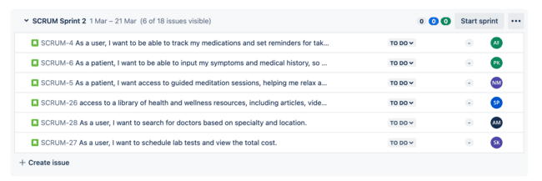
Stories planned and committed for sprint 2

Slide 39
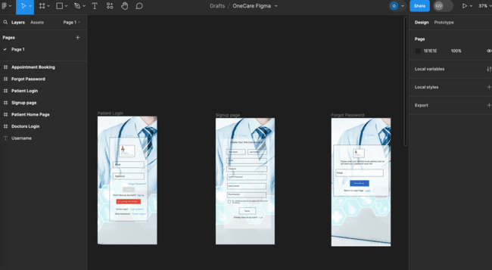
FIGMA DESIGN

Slide 40
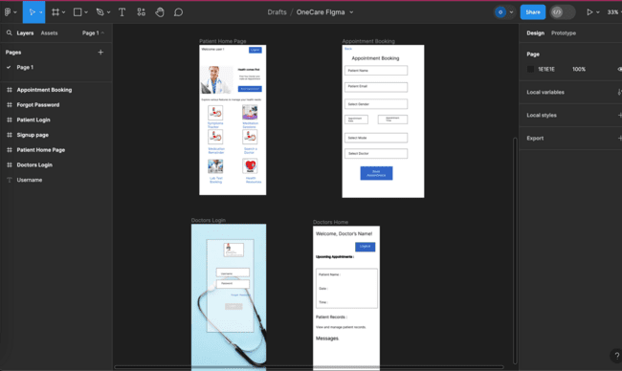

Slide 41

Project Demo – Sprint 1
Web Application Screenshots and Application walkthrough .

Slide 42
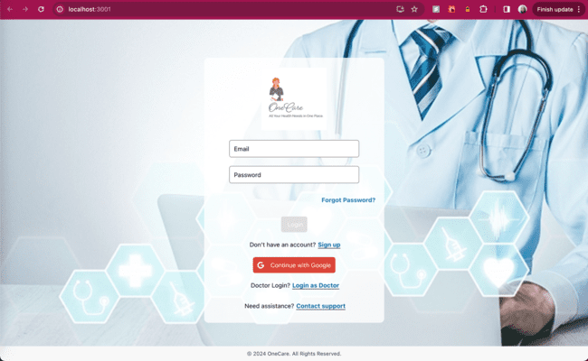
PATIENT LOGIN

Slide 43
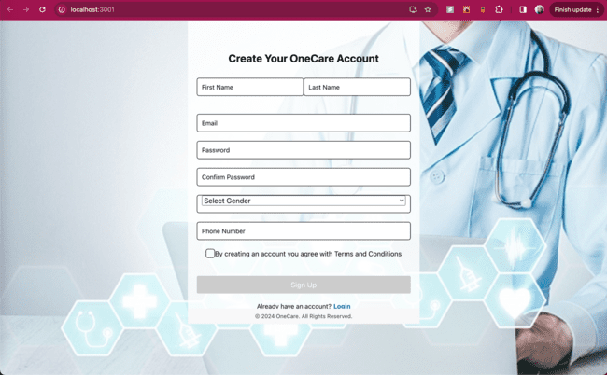
PATIENT ACCOUNT SIGNUP

Slide 44
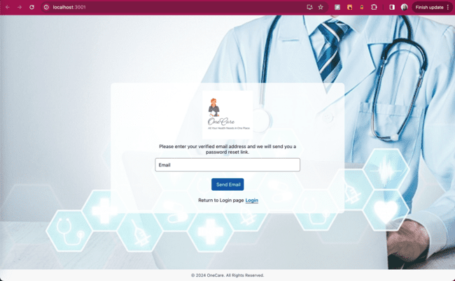
FORGOT PASSWORD/RESET PASSWORD

Slide 45
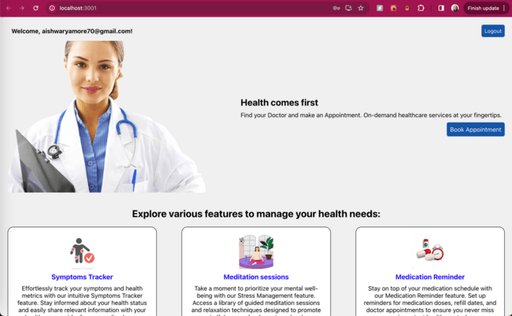
PATIENT LANDING PAGE

Slide 46
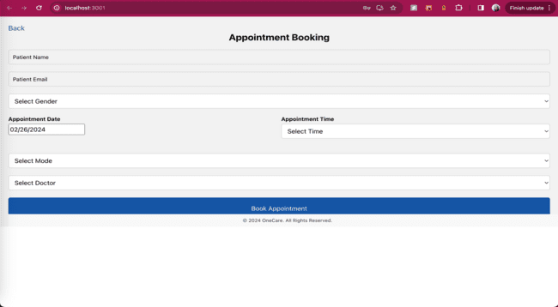
APPOINTMENT BOOKING

Slide 47
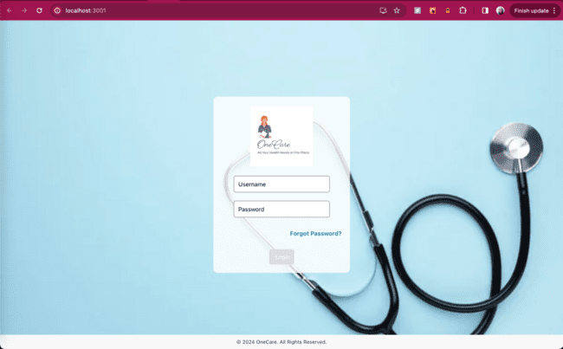
DOCTOR LOGIN

Slide 48
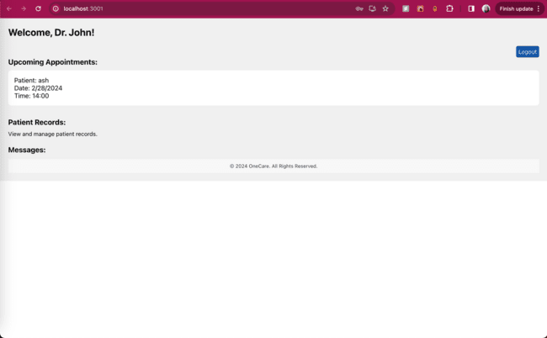
Doctors Homepage (Dashboard)

Slide 49

Lets Play a video of the live demo for our web app

Slide 50
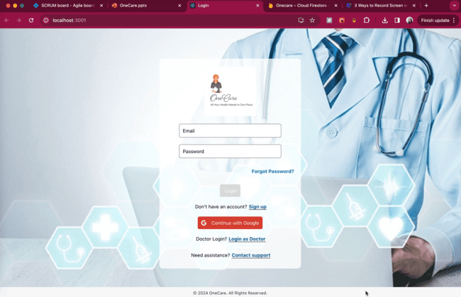

Slide 51

https://github.com/more-aishwarya/OneCare.git

Slide 52

THANK YOU

